Slide 1

APP TO BE IMPROVED: GMAIL
CS798H PROJECT
Ankush Yadav (210153)
Kavya Jalan (200503)
Vidish Chandekar (200291)
Tejas Goyal (211106)
CS798H

Slide 2
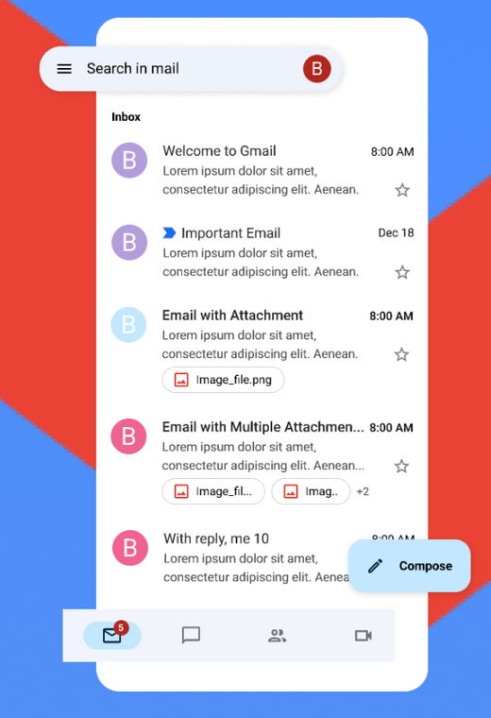
CURRENT APP: ITS PROBLEMS
AMATEURISH, UNINTUITIVE DESIGN
Difficult to navigate, Difficult to detect unopened mails, Difficult to detect notification
NO INBOX (AND RELATED SETTING)
Inbox by Gmail was an email service developed by Google, shutdown in 2019. Inbox would sort out all the emails properly and give users more flexibility and control
REGARDING FOLDERS, LABELS AND FILTERS
The app doesn’t allow searching folders (especially while moving mails), creating folders (making managing mails by users easier), and creating labels (making searching mails easier).

Slide 3
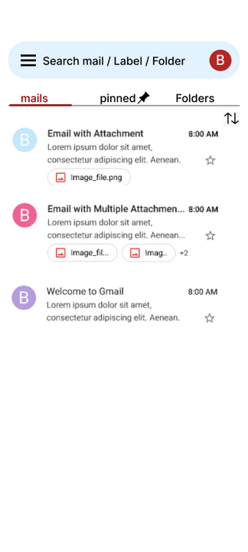
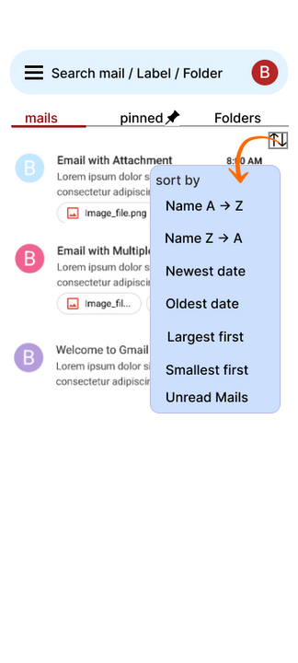
IMPROVING THE GENERAL USER INTERFACE
SEARCH BY MAIL/LABEL/FOLDER
Easy searching of mail, pinned mail, and folders in the search bar.
EASY NAVIGATION
Easy navigation between mails, pinned mails and folders.
UNREAD MAIL
We have provided feature to view unread mails.

Slide 4
IDEAS FROM GOOGLE INBOX
SORTING EMAILS BY NAME
We have included a feature to sort emails by name of sender.
SORTING EMAILS BY DATE
We have provided feature to sort emails by date of email recieved.
SORTING EMAILS BY SIZE
We have provided feature to sort emails by size.

Slide 5
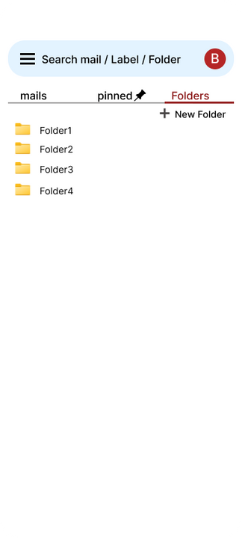
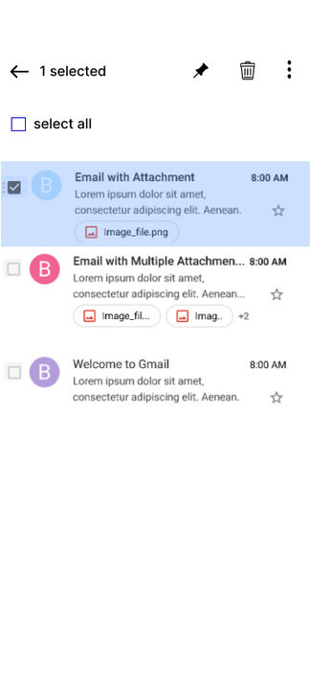
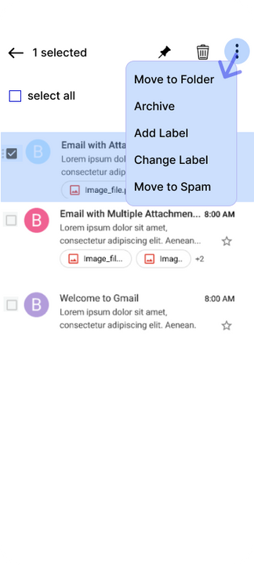
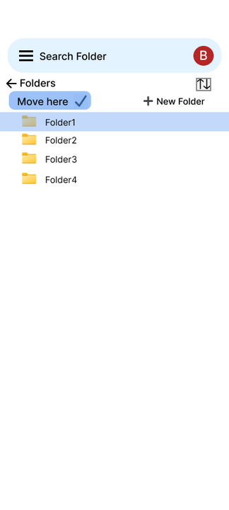
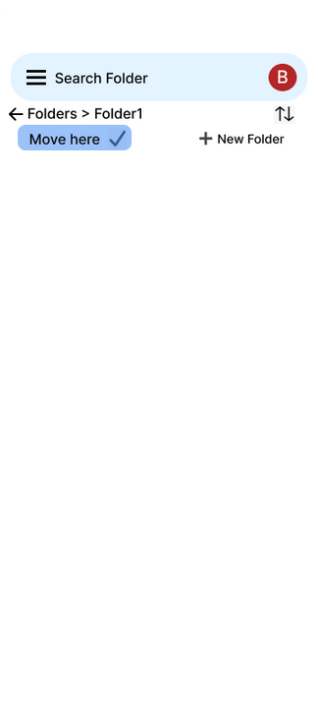
USE OF FOLDERS, LABELS, AND FILTERS
CREATING FOLDER AND MOVING MAILS TO FOLDERS
We have created option to create folders and move mails to them.

Slide 6
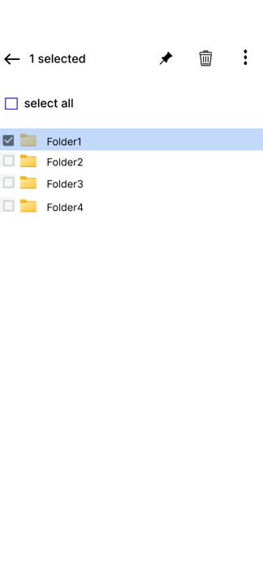
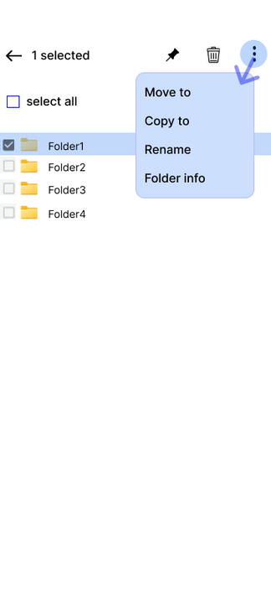
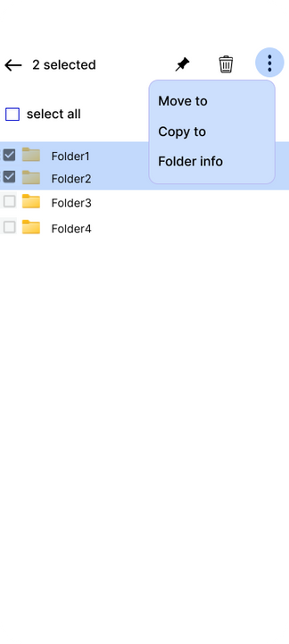
USE OF FOLDERS, LABELS, AND FILTERS
CREATING LABELS AND MOVING EMAILS FROM FOLDERS
We have included option to create labels and move emails from one or more and folders
Create Labels
Move emails from folders

Slide 7
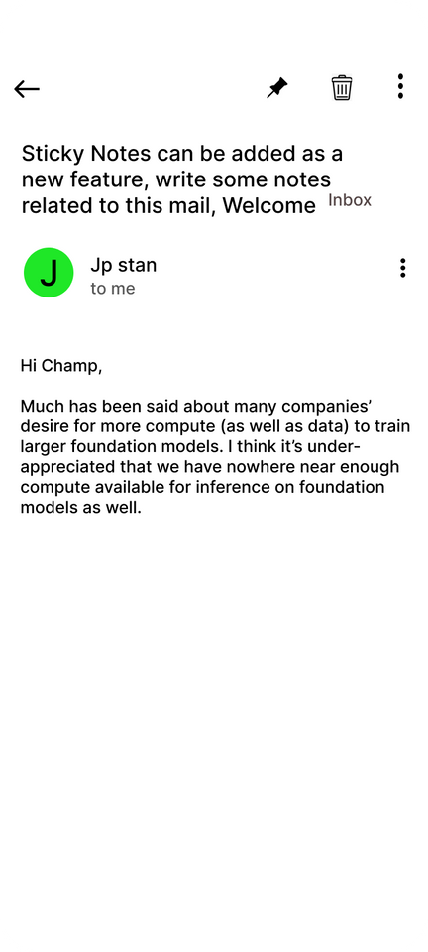
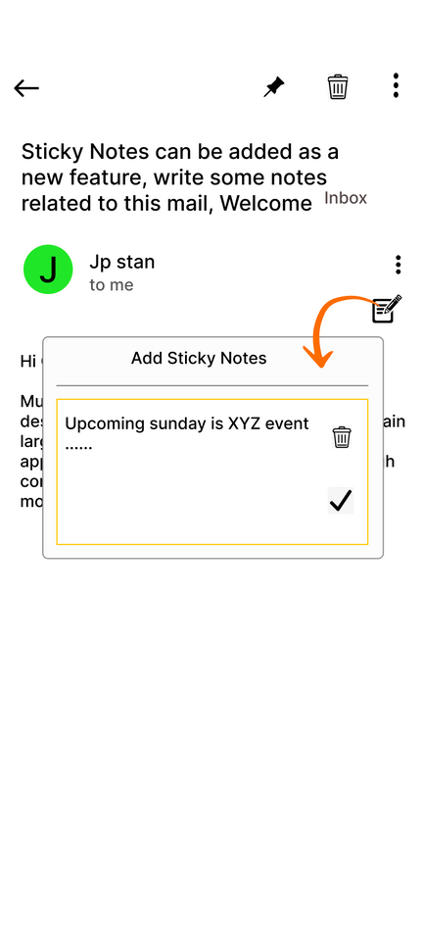
USE OF STICKY NOTES
STICKY NOTE(S) CAN BE ASSIGNED TO MAILS BY THE USER SO THAT THEY CAN REMEMBER IMPORTANT DETAILS/INFORMATION ABOUT THE SPECIFIC MAIL
Mail without a Sticky Note
Adding a Sticky Note

Slide 8
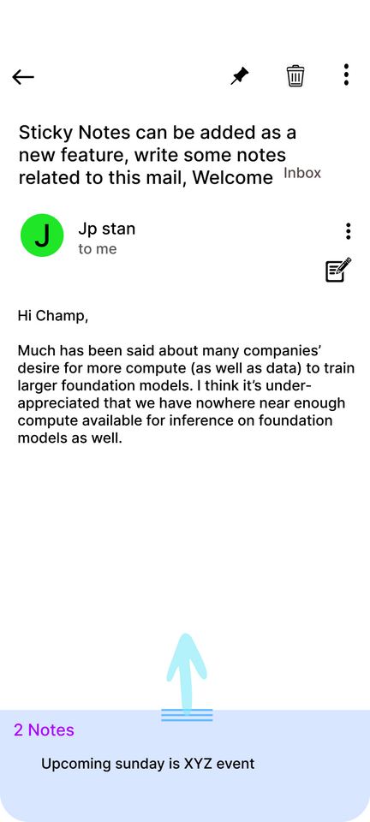
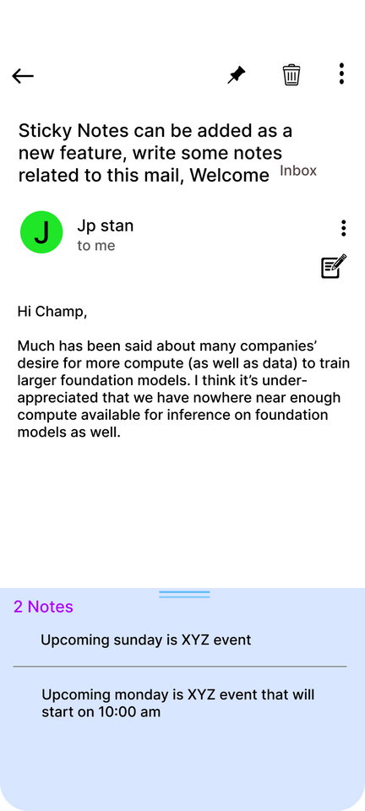
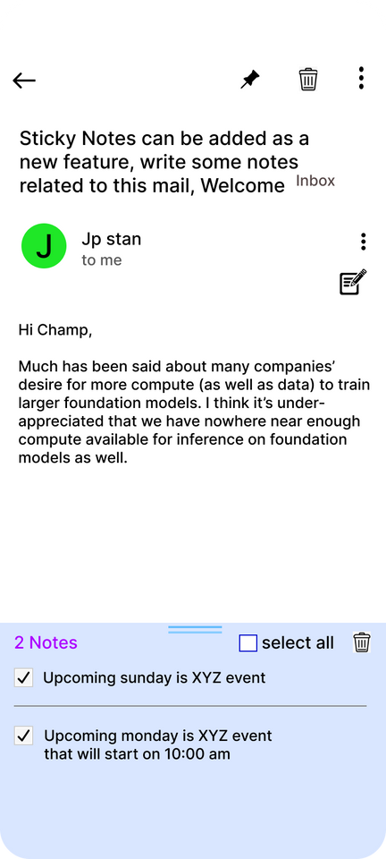
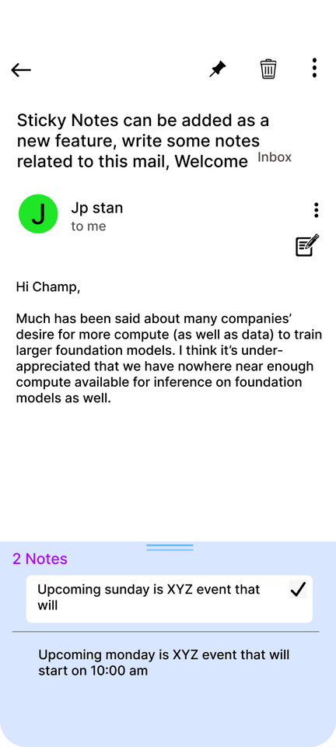
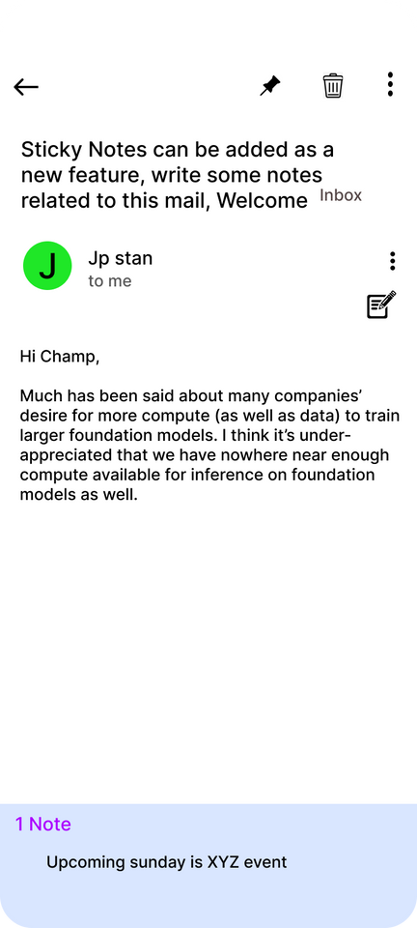
USE OF STICKY NOTES
Multiple Notes Attached to a Single Maill
Supports Editing Multiple Notes
A Note Attached to a Mail

Slide 9
PROTOTYPE EVALUATION
METHOD USED
We have used Heuristic Evaluation as our evaluation method
WHICH SPECIFIC HEURISTIC?
Specifically we’ve used Neilson and Nornal’s usability Heuristic. We’ve added an extra heuristic as well
WORKFLOW
We went through the 10 heuristic and questioned ourselves how our prototype compares in these individual aspects

Slide 10
HEURISTIC EVALUATION QUESTIONS
THESE WERE THE FOLLOWING QUESTIONS WE ASKED
Visibility Of System Status
Matching the System and the Real World
User Control the Freedom
Consistency and Standards
Error Prevention
Recognition Over Recall
Flexibility and Efficiency of Use
Aesthetic and Minimalistic Design
Permitting Reversal of Actions
Help and Documentation
Feedback and Error Messages

Slide 11
PROTOTYPE EVALUATION
THE POSITIVES
THE NEGATIVES
VISIBILITY OF SYSTEM STATUS
ERROR PREVENTION
By revamping the main UI, we are providing different background colors to read and unread mails, delivering a better visual experience.
Although not explicitly mentioned, this includes prevention and management of errors like making multiple labels/folders of the same name.
MATCHING THE SYSTEM WITH THE REAL WORLD
PERMITTING REVERSAL OF ACTIONS
The directory structure of mails is inspired by real-life bookshelves, allowing labeling, easy management and navigation; giving users more control.
Undo option is not provided, meaning any human mistake will have to be manually corrected and the user cannot go one command behind.

Slide 12
POTENTIAL FIXES - WHAT COULD WE HAVE DONE DIFFERENTLY?
COULD HAVE SCANNED MORE REVIEWS AND ADDED MORE PROBLEMS
Although we scanned through 30 reviews and figured out the problems, we could’ve scanned more reviews and could’ve even conducted surveys to identify more problems to fix.
WE COULD HAVE ADDED THE UNDO FEATURE
An undo feature like the ones we see in any OSwhere it allows you to undo the creation/movement of files/folders would have been a great addition
MORE COMPREHENSIVE DOCUMENTATION AND ERROR FEEDBACK SYSTEM
Since this was a first iteration mid-fidelity prototype, we did not feel the need to make a rigorous user manual and provide proper error messages but this could been done in this stage itself so that it’ll take some workload off of the later stages of development

Slide 13
IMPORTANT LINKS
HEURISTICS USED - NEILSEN AND NORMAL'S USABILITY HEURISTICS
FIGMA LINK FOR PROTOTYPE SHOWCASING FEATURES
HEURISTIC EVALUATION

Slide 14
THANK YOU

